Slide 1
Usable Skills
Fundamental Programming
Live lectures - https://cs50.harvard.edu/x/2022/zoom/
Coding Bat
Automate the Boring Stuff - Books/Automate the boring stuff with python.pdf at master · ThisIsSakshi/Books · GitHub
CRISP-DM & Pandas
SQL and Database modelling
Azure Data Fundamentals Cert – DP 900
Azure Data Engineering Cert – DP 203
Pyspark – Python and SQL at Scale.
https://towardsdatascience.com/a-brief-introduction-to-pyspark-ff4284701873

Slide 2
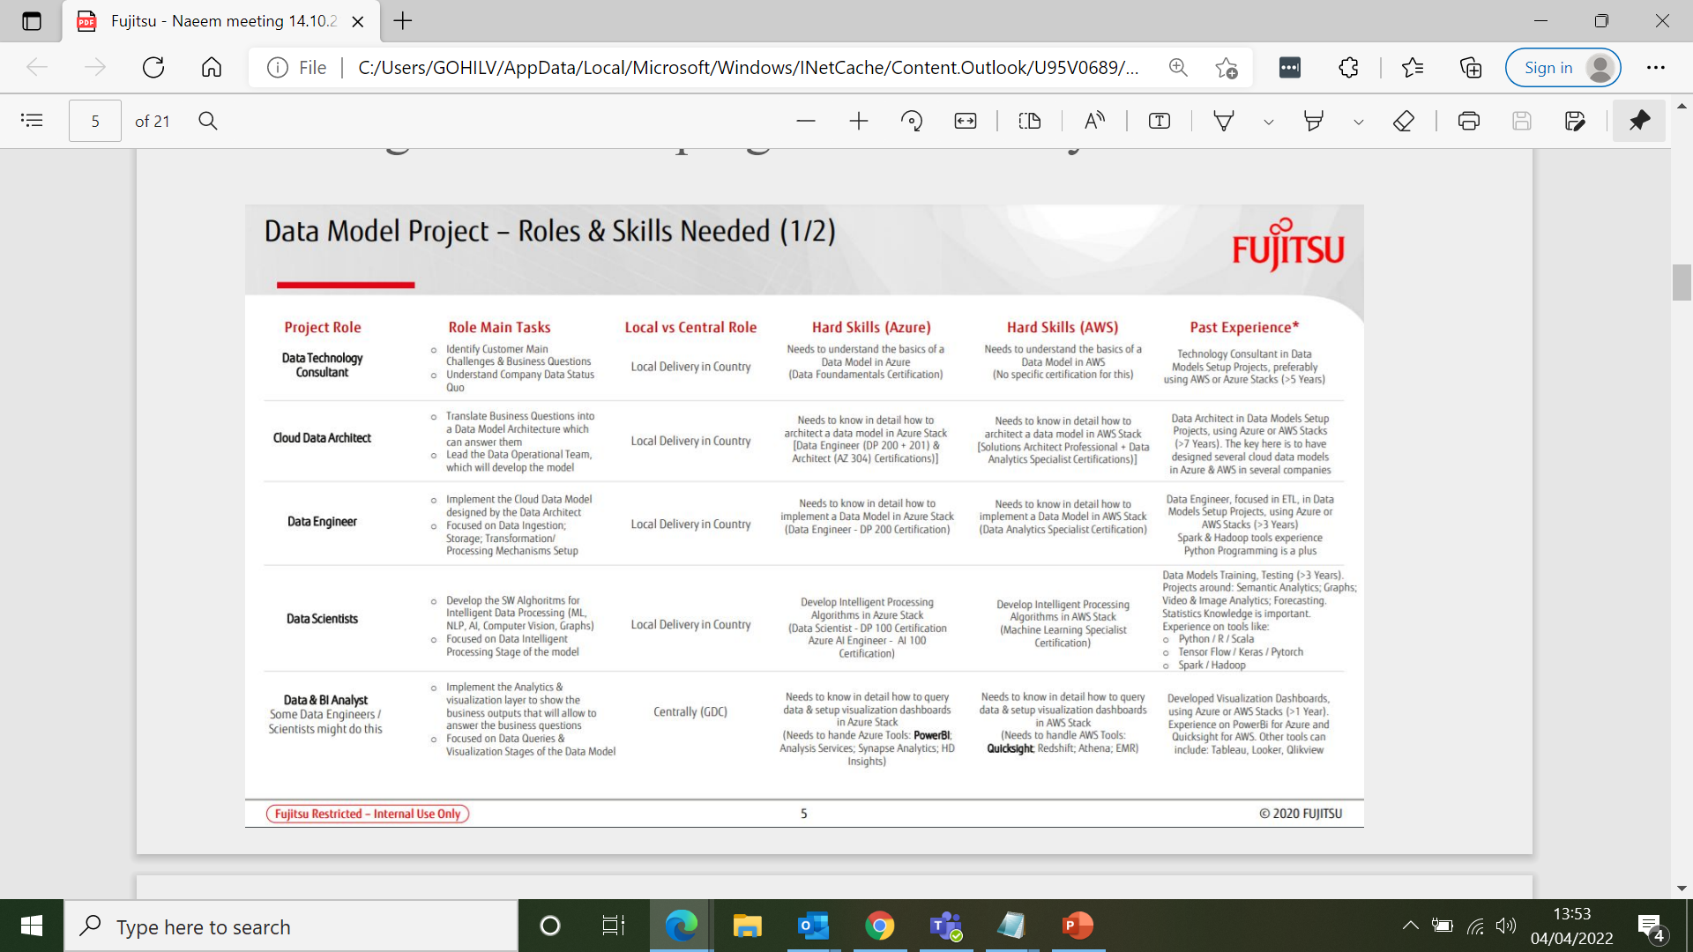
Notes:
DE, DS, Data and BI & Full Stack
No requirement for BI Analysts.
Requirement or Data Engineers and Data Scientists.
Full Stack means front and back-end development.
Coding Skills of a developer are always handy

Slide 3
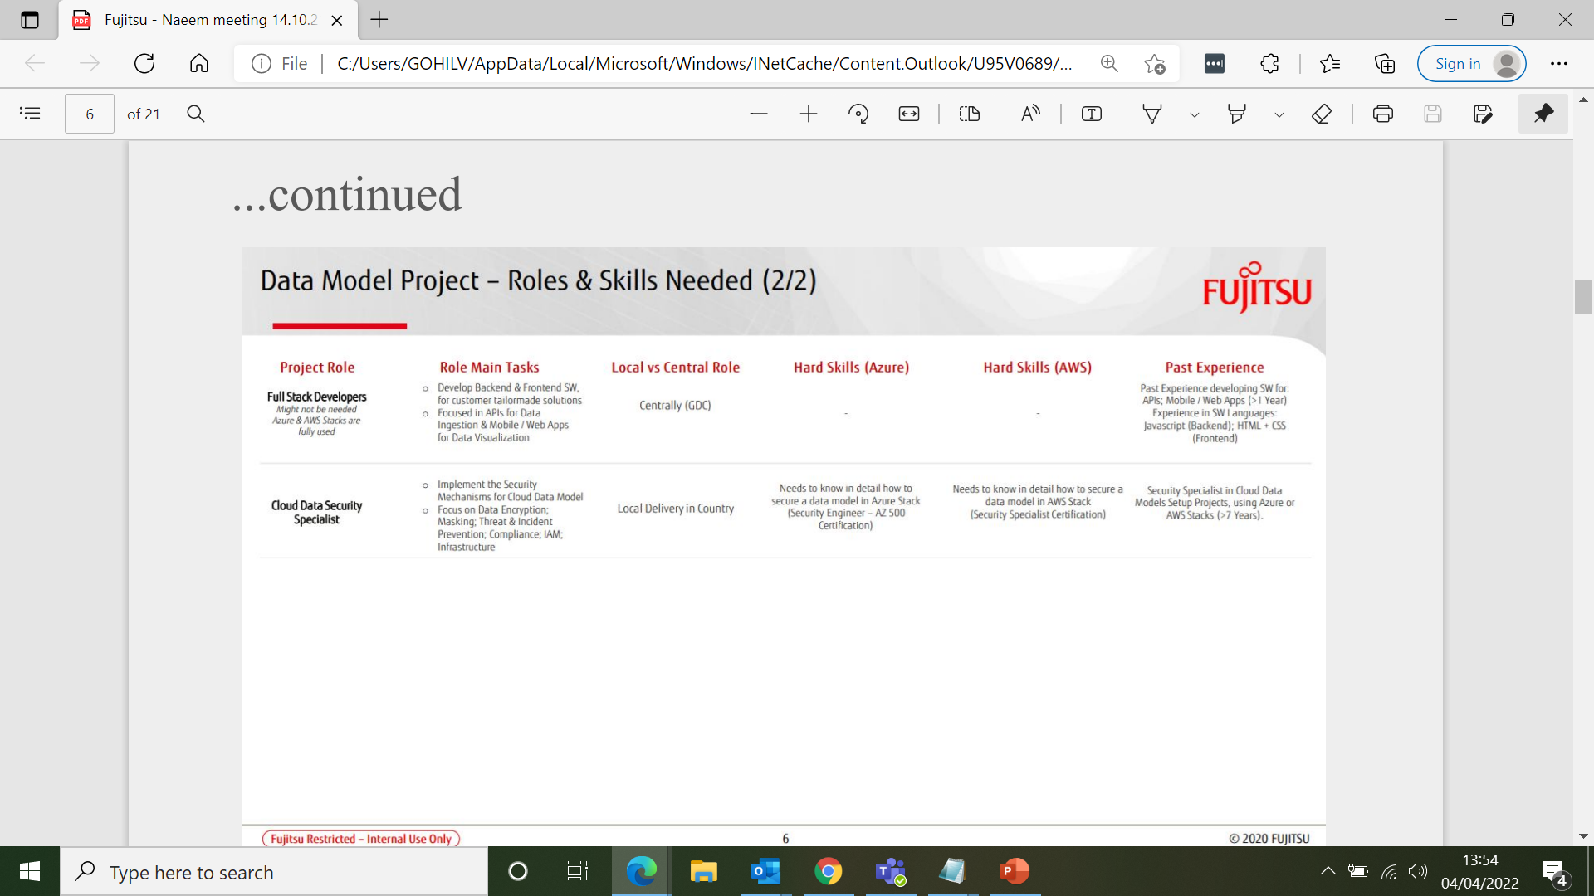

Slide 4
Role Types in Different Orgs
Data Scientist- BI Analyst, Power BI, Descriptive Stats, some ML
Data Scientist – Stats, ML models, Deep Learning.
Data Scientist – Coder, BI, ML, Deep Learning + Data Engineering.
Size of organisation.
Data Engineer- On prem storage, ETL with SSIS
98% of business still have some servers.
Data Engineer – Cloud Storage (Structured and Unstructured), ETL with Azure Data Factory, Python, Pyspark (Python and SQL on Databricks)
Data Engineer – Coder in Scala, Java on Databricks.
Notes:
Hot skills, batch and streaming, unstructured, semi structured and structured data.

Slide 5
IDEAL
CORE
Building a CRUD Web App (connect the programming to a DB)
Agile & Version Control
Machine Learning
C#
PROGRAMMING AND DS
Statistics & Machine Learning with Python (Numpy/Pandas/Scikit)
Algorithms and Data Structures
API's
Azure Data Science
AWS Data Science/Machine Learning
BUSINESS INTELLIGENCE
SSAS
Power BI
Azure Data Engineering
AWS Data Engineering

Slide 6
Usable Skills
Fundamental Programming
Live lectures - https://cs50.harvard.edu/x/2022/zoom/
Coding Bat
Automate the Boring Stuff - Books/Automate the boring stuff with python.pdf at master · ThisIsSakshi/Books · GitHub
CRISP-DM & Pandas
SQL and Database modelling
Azure Data Fundamentals Cert – DP 900
Azure Data Engineering Cert – DP 203
Pyspark

Slide 7
Microsoft certification / AWS certification - TBC
DP-900 data fundamentals
DP-100 data science
DP-203 data engineer
DP-090 databricks

